Slide 1

Angular Training {
beginners.html
workshop.css
[Beginners Workshop]
< Prepared by: Charles Adison >
}
Angular Training Beginner

Slide 2
Expectation from Participants; {
beginners.html
workshop.css
HTML Background
< Basic HTML and CSS >
Basic Programming Concepts
< i.e. using `if else`, `for loop` & basic `OOP` concept preferably >
}
Angular Training Beginner

Slide 3
Table Of Contents {
01
02
03
beginners.html
workshop.css
Angular Introduction
< What is special about Angular? >
Development Tools
< Creating our first boilerplate project >
Typescript 101
< Primary language of Angular >
}
Angular Training Beginner

Slide 4
Table Of Contents {
beginners.html
workshop.css
04
Angular Building Blocks
< Components and Modularization >
05
Empower your HTML
< Binding Types, Directives and Pipes >
}
Angular Training Beginner

Slide 5
01 {
[Angular Introduction]
beginners.html
workshop.css
< What is special about Angular? >
}
Angular Training - Introduction

Slide 6
What is Angular {
beginners.html
workshop.css
< Angular is more than just a frontend framework with which to build Single Page Applications (SPA). It is a full-fledged development platform built on TypeScript. >
< AngularJS and Angular 2+ or just Angular are two entirely different frameworks. >
}
Angular Training - Introduction
Notes:
Angular is more than just a frontlibraries that cover a wend framework with which to build Single Page Applications (SPA). It is a full-fledged development platform built on TypeScript that comprises:
A component-based framework for building scalable web applications.
A collection of well-integrated ide variety of features including routing, form management, client-server communication, progressive web apps and more.
A suite of developer tools to help you develop, build, test, and update your code via the Angular CLI.

Slide 7
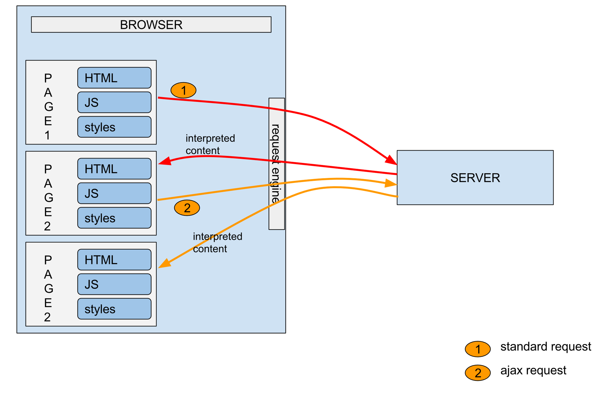
Server Generated Pages; {
beginners.html
workshop.css
}
Angular Training - Introduction
Notes:
Server-generated pages:
The presentation and the data of each page is generated by the server before delivering it to the client
Generally stateful (it means that data is shared during page navigation using sessions and cookies)
The UI and business logic are coupled
The response body is generally heavier because it contains both the UI and the data
Also called multi-page applications (because each view is represented by a separate page)
Some example frameworks: PHP, Symphony, JSP, Tapestry, ASP Razor pages

Slide 8
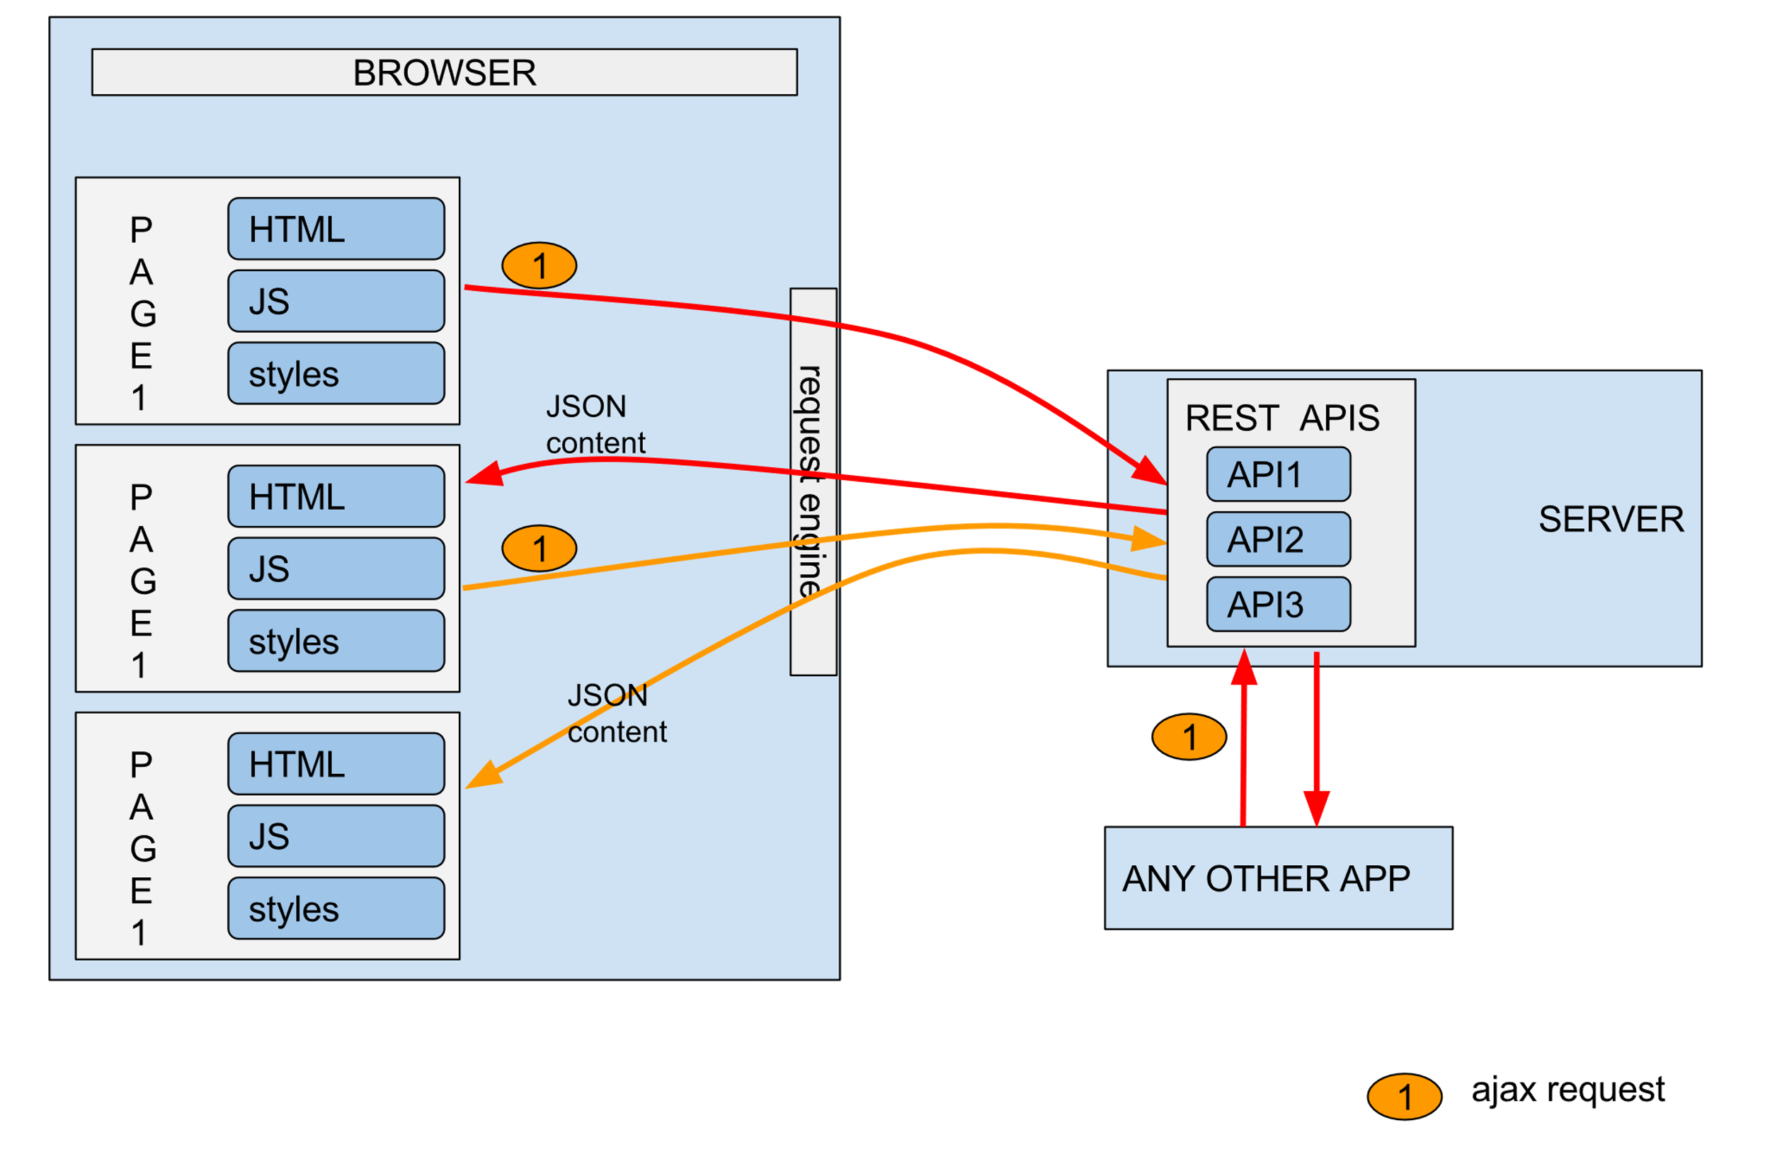
Single Page Application; {
beginners.html
workshop.css
}
Angular Training - Introduction
Notes:
Single Page Application (SPA) + API:
The UI consists of a single static HTML file. The file is said to be static because the server does not modify the page before delivering it
The data is dynamically fetched from the server when the client needs it
The server that serves the data is commonly called an API/backend server
The data is generally in JSON format
It is not necessary to provide an API (for example, a video game SPA)
The page content is altered by the client through DOM manipulation. This allows, for example, to simulate a view or page change
The client uses Javascript in order to fetch dynamic data and manipulate the DOM
This model is similar to the one used in mobile apps (the SPA is analogous to the mobile app)

Slide 9


Leading SPA Frameworks; {
beginners.html
workshop.css
Angular
< free and open-source led by the Angular Team at Google >
ReactJS
< developed by Facebook, Jordan Walke >
Vue.js
< created by Evan You as a personal side project, independent & community driven >
}
Angular Training - Introduction
Notes:
SPA disadvantage: SEO, heavy reliant in javascript
SPA samples: Google Maps, Gmail, Netflix, Trello, Twitter, Youtube
Angular is open source, js framework

Slide 10
Advantages of Angular; {
beginners.html
workshop.css
* Scalability mainly used for enterprise projects
* Rich official library ecosystem
* It is very well documented
* The Angular team takes a lot of pride in how easy they make updating Angular projects
}
Angular Training - Introduction
Notes:
It is particularly well suited to projects that need to scale and to that effect, it is mainly used for enterprise projects.
Its rich official library ecosystem enables great consistency across projects which means that when transferring teams or projects you will only need to learn about the new business domain and not an entirely new way of doing things because another library set choice was made.
It is very well documented and the consistency in the way the framework is used means you are more than likely to find any question you may encounter along your learning journey already answered.
The Angular team takes a lot of pride in how easy they make updating Angular projects, providing easy steps to follow and some fully automated migration.

Slide 11
02 {
[Development Tools]
beginners.html
workshop.css
< Creating our first boilerplate project >
}
Angular Training - Development Tools

Slide 12


Tooling - Prerequisites; {
beginners.html
workshop.css
Node.js
< is an open-source, cross-platform JavaScript runtime environment >
* Angular, the Angular CLI depend on npm packages for many features and function. To download and install npm packages, npm package manager is needed
* npm client is installed by Node.js by default
Visual Studio Code
< source-code editor made by Microsoft with Electron framework >
}
Angular Training – Development Tools
Notes:
Nodejs download: https://nodejs.org/en
Check version: node –v
Check npm version: npm -v

Slide 13
Angular CLI & our first project {
beginners.html
workshop.css
1. npm install -g @angular/cli@15.2.10
2. ng new project-name
}
Angular Training - Development Tools
Notes:
Navigate through the file structure
Our previously created project has the following folders and files:
.eslintrc.json: the default ESLint configuration of the workspace
tsconfig.json: the base TypeScript configuration for projects in the workspace
tsconfig.app.json: the root application TypeScript configuration file which inherits from the base one
tsconfig.spec.json: the e2e tests TypeScript configuration file which inherits from the base one
README.md: introductory documentation for the root app
package.json: configures npm package dependencies that are available to all projects in the workspace
package-lock.json: provides version information for all packages installed into node_modules by the npm client
angular.json: CLI configuration, including configuration options for build, serve, and test tools that the CLI uses
The src folder contains:
styles.scss: Lists CSS files that supply styles for a project. The extension reflects the style preprocessor you have configured for the project.
main.ts: The main entry point for your application
index.html: The main HTML page that is served when someone visits your site. The CLI automatically adds all JavaScript and CSS files when building your app, so you typically don't need to add any <script> or <link> tags here manually.
favicon.ico: An icon to use for this application in the bookmark bar
assets: Contains image and other asset files to be copied as-is when you build your application
app: Contains the component files in which your application logic and data are defined
The app folder contains:
app.module.ts: Defines the root module, named AppModule, that tells Angular how to assemble the application. Initially declares only the AppComponent. As you add more components to the app, they must be declared here.
app-routing.module.ts: Defines a routing module for the AppModule
app.component.html: Defines the HTML template associated with the root AppComponent
app.component.scss: Defines the base stylesheet for the root AppComponent
app.component.ts: Defines the logic for the app's root component, named AppComponent. The view associated with this root component is the root of the view hierarchy.
app.component.spec.ts: Defines a unit test for the root AppComponent
.gitignore: Specifies intentionally untracked files that Git should ignore
.editorconfig: Configuration for code editors
src: Source files for the root-level application project
node_modules: Provides npm packages to the entire workspace

Slide 14
Verify setup {
beginners.html
workshop.css
* Check node version by running node –v in the command prompt. You should be able to see the version number if setup is correct. * For Angular CLI, after installation, run ng version – it should display the angular information.
}
Angular Training - Development Tools
Notes:
It is particularly well suited to projects that need to scale and to that effect, it is mainly used for enterprise projects.
Its rich official library ecosystem enables great consistency across projects which means that when transferring teams or projects you will only need to learn about the new business domain and not an entirely new way of doing things because another library set choice was made.
It is very well documented and the consistency in the way the framework is used means you are more than likely to find any question you may encounter along your learning journey already answered.
The Angular team takes a lot of pride in how easy they make updating Angular projects, providing easy steps to follow and some fully automated migration.

Slide 15
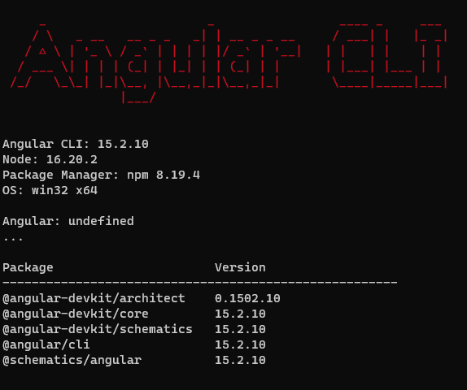
Verify setup {
beginners.html
workshop.css
}
Angular Training - Development Tools
Notes:
It is particularly well suited to projects that need to scale and to that effect, it is mainly used for enterprise projects.
Its rich official library ecosystem enables great consistency across projects which means that when transferring teams or projects you will only need to learn about the new business domain and not an entirely new way of doing things because another library set choice was made.
It is very well documented and the consistency in the way the framework is used means you are more than likely to find any question you may encounter along your learning journey already answered.
The Angular team takes a lot of pride in how easy they make updating Angular projects, providing easy steps to follow and some fully automated migration.

Slide 16
Key File Structure {
beginners.html
workshop.css
* package.json configures npm package dependencies that are available to all projects in the workspace
* angular.json CLI configuration, including configuration options for build, serve, and test tools that the CLI uses
* node_modules provides npm packages to the entire workspace
* src Source files for the root-level application project
}
Angular Training - Development Tools
Notes:
It is particularly well suited to projects that need to scale and to that effect, it is mainly used for enterprise projects.
Its rich official library ecosystem enables great consistency across projects which means that when transferring teams or projects you will only need to learn about the new business domain and not an entirely new way of doing things because another library set choice was made.
It is very well documented and the consistency in the way the framework is used means you are more than likely to find any question you may encounter along your learning journey already answered.
The Angular team takes a lot of pride in how easy they make updating Angular projects, providing easy steps to follow and some fully automated migration.

Slide 17
Run the project {
beginners.html
workshop.css
1. npm run start or ng serve
}
Angular Training - Development Tools
Notes:
Navigate through the file structure
Our previously created project has the following folders and files:
.eslintrc.json: the default ESLint configuration of the workspace
tsconfig.json: the base TypeScript configuration for projects in the workspace
tsconfig.app.json: the root application TypeScript configuration file which inherits from the base one
tsconfig.spec.json: the e2e tests TypeScript configuration file which inherits from the base one
README.md: introductory documentation for the root app
package.json: configures npm package dependencies that are available to all projects in the workspace
package-lock.json: provides version information for all packages installed into node_modules by the npm client
angular.json: CLI configuration, including configuration options for build, serve, and test tools that the CLI uses
The src folder contains:
styles.scss: Lists CSS files that supply styles for a project. The extension reflects the style preprocessor you have configured for the project.
main.ts: The main entry point for your application
index.html: The main HTML page that is served when someone visits your site. The CLI automatically adds all JavaScript and CSS files when building your app, so you typically don't need to add any <script> or <link> tags here manually.
favicon.ico: An icon to use for this application in the bookmark bar
assets: Contains image and other asset files to be copied as-is when you build your application
app: Contains the component files in which your application logic and data are defined
The app folder contains:
app.module.ts: Defines the root module, named AppModule, that tells Angular how to assemble the application. Initially declares only the AppComponent. As you add more components to the app, they must be declared here.
app-routing.module.ts: Defines a routing module for the AppModule
app.component.html: Defines the HTML template associated with the root AppComponent
app.component.scss: Defines the base stylesheet for the root AppComponent
app.component.ts: Defines the logic for the app's root component, named AppComponent. The view associated with this root component is the root of the view hierarchy.
app.component.spec.ts: Defines a unit test for the root AppComponent
.gitignore: Specifies intentionally untracked files that Git should ignore
.editorconfig: Configuration for code editors
src: Source files for the root-level application project
node_modules: Provides npm packages to the entire workspace

Slide 18
03 {
[Typescript 101]
beginners.html
workshop.css
< Primary language of Angular >
}
Angular Training - Typescript

Slide 19
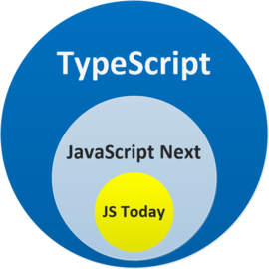
What is Typescript {
beginners.html
workshop.css
* TypeScript offers all of JavaScript’s features, and an additional layer on top of these: TypeScript’s type system
* TypeScript is a language that
is a superset of JavaScript:
JS syntax is therefore
legal TS
}
Angular Training - Typescript

Slide 20
Structural Typing {
beginners.html
workshop.css
* In a structural type system, if two objects have the same shape, they are considered same type
* Also called duck typing where in computer programming is an application of the duck test—"If it walks like a duck and it quacks like a duck, then it must be a duck"—to determine whether an object can be used for a particular purpose
}
Angular Training - Typescript

Slide 21
Structural Typing Sample {
beginners.html
workshop.css
interface Point {
x: number;
y: number;
}
function logPoint(point: Point): void {
console.log(`${point.x}, ${point.y}`);
}
// logs "12, 26"
const force = { x: 12, y: 26 };
logPoint(force);
const color = { hex: '#187ABF' }
logPoint(color) //error
}
Angular Training - Typescript
Notes:
If you want to play around in TypeScript, you can either install it locally
npm install -g typescript,
put your code in a .ts file and run tsc path/to/file.ts to compile it
or try directly online in a https://www.typescriptlang.org/play?#code
>node 01-structural-typing.js

Slide 22

Data Types {
beginners.html
workshop.css
< TypeScript doesn’t use types on the left-style declarations like int x = 0. Type annotations will always go after the thing being typed. >
* Common Primitives string, number, boolean
* Basic Types any, object, undefined, null, void, never, unknown, T[], [T, U], enum
* Union Types formed from two or more other types
}
Angular Training - Typescript
Notes:
any an untyped value
object a non-primitive value
undefined an uninitialized value
null an explicitly empty value
void represents the return value of functions which don’t return a value. It’s the inferred type any time a function doesn’t have any return statements, or doesn’t return any explicit value from those return statements
never represents values which are never observed. In a return type, this means that the function throws an exception or terminates the execution of the program.
unknown represents any value. This is similar to the any type, but is safer because it’s not legal to do anything with an unknown value
T[] an array of type T, can also be written Array<T>
[T, U] a tuple of type T and U
enum

Slide 23
Other Data Types {
beginners.html
workshop.css
* Union Types formed from two or more other types
* Literal Types we can refer to specific strings and numbers in type positions
function printId(id: number | string) {
console.log('Your ID is ' + id);
}
function printText(s: string, alignment: 'left' | 'right' | 'center') {
// ...
}
}
Angular Training - Typescript
Notes:
any an untyped value
object a non-primitive value
undefined an uninitialized value
null an explicitly empty value
void represents the return value of functions which don’t return a value. It’s the inferred type any time a function doesn’t have any return statements, or doesn’t return any explicit value from those return statements
never represents values which are never observed. In a return type, this means that the function throws an exception or terminates the execution of the program.
unknown represents any value. This is similar to the any type, but is safer because it’s not legal to do anything with an unknown value
T[] an array of type T, can also be written Array<T>
[T, U] a tuple of type T and U
enum

Slide 24

const, let and var {
beginners.html
workshop.css
* Mutable variables which are declared using the let keyword. The legacy var keyword can also be used but is not recommended because of its way of handling scope can be misleading.
* Immutable variables or constants are declared with const. Please note that fields of constants can still be modified, constants just can't be reassigned.
}
Angular Training - Typescript
Notes:
any an untyped value
object a non-primitive value
undefined an uninitialized value
null an explicitly empty value
void represents the return value of functions which don’t return a value. It’s the inferred type any time a function doesn’t have any return statements, or doesn’t return any explicit value from those return statements
never represents values which are never observed. In a return type, this means that the function throws an exception or terminates the execution of the program.
unknown represents any value. This is similar to the any type, but is safer because it’s not legal to do anything with an unknown value
T[] an array of type T, can also be written Array<T>
[T, U] a tuple of type T and U
enum

Slide 25
const, let and var Sample {
beginners.html
workshop.css
let x = 10
var y = 200.0 // ! do not use var, use let instead
const t = [1, 2, 3]
t = ['a', 'b'] // ! error because it's a const
t.push(4) // ok
const meal = { name: "sandwich" }
meal = { name: "soup" } // ! error
meal.name = "soup" // ok
}
Angular Training - Typescript
Notes:
any an untyped value
object a non-primitive value
undefined an uninitialized value
null an explicitly empty value
void represents the return value of functions which don’t return a value. It’s the inferred type any time a function doesn’t have any return statements, or doesn’t return any explicit value from those return statements
never represents values which are never observed. In a return type, this means that the function throws an exception or terminates the execution of the program.
unknown represents any value. This is similar to the any type, but is safer because it’s not legal to do anything with an unknown value
T[] an array of type T, can also be written Array<T>
[T, U] a tuple of type T and U
enum

Slide 26
Functions {
beginners.html
workshop.css
// enum
enum Direction {
East = 'EAST',
West = 'WEST',
South = 'SOUTH',
North = 'NORTH'
}
const direction = Direction.East
// tuple
let currentWeather: [string, number, Direction];
currentWeather = ['sunny', 22, Direction.South];
function describeWeather(weather: [string, number, Direction]): void {
console.log(`The weather is ${weather[0]}, with a temperature of ${weather[1]}`);
}
describeWeather(currentWeather); //logs "The weather is sunny, with a temperature of 22"
describeWeather(direction); // Error
}
Angular Training - Typescript
Notes:
Functions are the primary means of passing data around in JavaScript.
TypeScript allows you to specify the types of both the input and output values of functions.

Slide 27
Dealing with null & undefined {
beginners.html
workshop.css
* How null and undefined behave depends on whether the strictNullChecks TypeScript compiler option is on or off
* strictNullChecks on is recommended to avoid possible runtime errors like in Java
}
Angular Training - Typescript
Notes:
strictNullChecks off
Values that might be null or undefined can still be accessed normally, and the values null and undefined can be assigned to a property of any type.
This is similar to how languages without null checks (e.g. Java, C# before version 8) behave.
The lack of checking for these values tends to be a major source of bugs; it is strongly recommanded to turn strictNullChecks on if it’s practical to do so in your codebase.
strictNullChecks on
When a value is null or undefined, you will need to test for those values before using methods or properties on that value. Here are the various strategies available to you:

Slide 28
Optional Chaining {
beginners.html
workshop.css
< The ? operator - lets us write code where TypeScript can immediately stop running some expressions if we run into a null or undefined >
let currentWind: Wind | undefined;
console.log(currentWind.direction); // [ERR] Object is possibly 'undefined'.
console.log(currentWind?.direction); // logs undefined
}
Angular Training - Typescript
Notes:
strictNullChecks off
Values that might be null or undefined can still be accessed normally, and the values null and undefined can be assigned to a property of any type.
This is similar to how languages without null checks (e.g. Java, C# before version 8) behave.
The lack of checking for these values tends to be a major source of bugs; it is strongly recommanded to turn strictNullChecks on if it’s practical to do so in your codebase.
strictNullChecks on
When a value is null or undefined, you will need to test for those values before using methods or properties on that value. Here are the various strategies available to you:

Slide 29
Nullish coalescing {
beginners.html
workshop.css
< The ?? operator is a way to fall back to a default value when dealing with null or undefined>
let windSpeed: number | undefined;
console.log(windSpeed ?? 'no data yet'); // logs no data yet
// Acquiring data ...
windSpeed = 23;
console.log(windSpeed ?? 'no data yet'); // logs 23
}
Angular Training - Typescript
Notes:
strictNullChecks off
Values that might be null or undefined can still be accessed normally, and the values null and undefined can be assigned to a property of any type.
This is similar to how languages without null checks (e.g. Java, C# before version 8) behave.
The lack of checking for these values tends to be a major source of bugs; it is strongly recommanded to turn strictNullChecks on if it’s practical to do so in your codebase.
strictNullChecks on
When a value is null or undefined, you will need to test for those values before using methods or properties on that value. Here are the various strategies available to you:

Slide 30

Logical OR {
beginners.html
workshop.css
< The || operator – is another way to fall back to a default value when dealing with falsy values other than null and undefined>
let windSpeed: number | undefined;
console.log(windSpeed || 'no data yet'); // logs no data yet
// Acquiring data ...
windSpeed = 0;
console.log(windSpeed || 'no data yet'); // logs 0
}
Angular Training - Typescript
Notes:
strictNullChecks off
Values that might be null or undefined can still be accessed normally, and the values null and undefined can be assigned to a property of any type.
This is similar to how languages without null checks (e.g. Java, C# before version 8) behave.
The lack of checking for these values tends to be a major source of bugs; it is strongly recommanded to turn strictNullChecks on if it’s practical to do so in your codebase.
strictNullChecks on
When a value is null or undefined, you will need to test for those values before using methods or properties on that value. Here are the various strategies available to you:

Slide 31
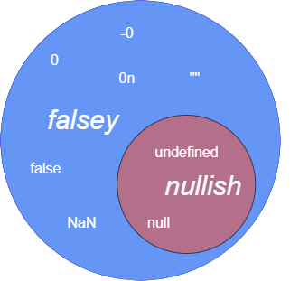

Nullish vs OR operator {
beginners.html
workshop.css
}
Angular Training - Typescript
Notes:
strictNullChecks off
Values that might be null or undefined can still be accessed normally, and the values null and undefined can be assigned to a property of any type.
This is similar to how languages without null checks (e.g. Java, C# before version 8) behave.
The lack of checking for these values tends to be a major source of bugs; it is strongly recommanded to turn strictNullChecks on if it’s practical to do so in your codebase.
strictNullChecks on
When a value is null or undefined, you will need to test for those values before using methods or properties on that value. Here are the various strategies available to you:

Slide 32

Classes {
beginners.html
workshop.css
< TypeScript offers full support for the class keyword introduced in ES2015 >
* Class Members fields, constructors, methods
* Member Visibility public, private, protected
* Class Inheritance implements, extends
}
Angular Training - Typescript

Slide 33
Classes {
beginners.html
workshop.css
class Point {
x: number
y: number
z = 0
constructor(x: number, y: number = 0) {
this.x = x
this.y = y
}
scale(n: number): void {
this.x = this.x * n
this.y = this.y * n
}
}
const pt = new Point(10)
console.log(pt.y) // logs 0
pt.x = 0
pt.y = 7
pt.y = "0" // Type 'string' is not assignable to type 'number'.
}
Angular Training - Typescript

Slide 34
Class Inheritance {
beginners.html
workshop.css
< Like other languages with object-oriented features, classes in JavaScript can inherit from base classes >
interface Pingable {
ping(): void
}
class Sonar implements Pingable {
ping() {
console.log("ping!")
}
}
class Ball implements Pingable {
//Class 'Ball' incorrectly implements interface 'Pingable'.
// Property 'ping' is missing in type 'Ball' but required in type 'Pingable'.
pong() {
console.log("pong!")
}
}
}
Angular Training - Typescript

Slide 35
04 {
[Angular Building Blocks]
beginners.html
workshop.css
< Components and modules >
}
Angular Training - Building Blocks

Slide 36
Angular Component {
forbeginners.html
workshop.css
* a component is a class decorated with the @Component decorator
* it is generated via the CLI by the ng g c component-name command
* by default, a component is generated with an associated html file and stylesheet file
}
Angular Training - Building Blocks
Notes:
It is particularly well suited to projects that need to scale and to that effect, it is mainly used for enterprise projects.
Its rich official library ecosystem enables great consistency across projects which means that when transferring teams or projects you will only need to learn about the new business domain and not an entirely new way of doing things because another library set choice was made.
It is very well documented and the consistency in the way the framework is used means you are more than likely to find any question you may encounter along your learning journey already answered.
The Angular team takes a lot of pride in how easy they make updating Angular projects, providing easy steps to follow and some fully automated migration.

Slide 37

Angular Component {
forbeginners.html
workshop.css
import { Component, OnInit } from '@angular/core' //[3]
import { HeroService } from '@services/hero.service.ts'
import { Hero } from '@models/hero.ts'
@Component({ //[2]
selector: 'app-hero-list',
templateUrl: './hero-list.component.html',
styleUrls: ['./hero-list.component.scss']
})
export class HeroListComponent implements OnInit { //[1]
heroes: Hero[]
selectedHero: Hero
constructor(private service: HeroService) { }
ngOnInit() {
this.heroes = this.service.getHeroes();
}
selectHero(hero: Hero) {
this.selectedHero = hero;
}
}
}
Angular Training - Building Blocks
Notes:
It is particularly well suited to projects that need to scale and to that effect, it is mainly used for enterprise projects.
Its rich official library ecosystem enables great consistency across projects which means that when transferring teams or projects you will only need to learn about the new business domain and not an entirely new way of doing things because another library set choice was made.
It is very well documented and the consistency in the way the framework is used means you are more than likely to find any question you may encounter along your learning journey already answered.
The Angular team takes a lot of pride in how easy they make updating Angular projects, providing easy steps to follow and some fully automated migration.

Slide 38
[1] Classes {
forbeginners.html
workshop.css
* The main building blocks of Angular (services, components, pipes, directives...) are classes
* The constructor mainly serves dependency injection purposes
}
Angular Training - Building Blocks
Notes:
It is particularly well suited to projects that need to scale and to that effect, it is mainly used for enterprise projects.
Its rich official library ecosystem enables great consistency across projects which means that when transferring teams or projects you will only need to learn about the new business domain and not an entirely new way of doing things because another library set choice was made.
It is very well documented and the consistency in the way the framework is used means you are more than likely to find any question you may encounter along your learning journey already answered.
The Angular team takes a lot of pride in how easy they make updating Angular projects, providing easy steps to follow and some fully automated migration.

Slide 39

[2] Decorators {
forbeginners.html
workshop.css
* A Decorator is a special kind of declaration that can be attached to a class declaration, method, accessor, property, or parameter
* Decorators use the form @expression, where expression must evaluate to a function that will be called at runtime with information about the decorated declaration
* @Directive, @Injectable, @Pipe, @Input, @Output
}
Angular Training - Building Blocks
Notes:
It is particularly well suited to projects that need to scale and to that effect, it is mainly used for enterprise projects.
Its rich official library ecosystem enables great consistency across projects which means that when transferring teams or projects you will only need to learn about the new business domain and not an entirely new way of doing things because another library set choice was made.
It is very well documented and the consistency in the way the framework is used means you are more than likely to find any question you may encounter along your learning journey already answered.
The Angular team takes a lot of pride in how easy they make updating Angular projects, providing easy steps to follow and some fully automated migration.

Slide 40

[3] ES6 modules {
forbeginners.html
workshop.css
* ES6 modules are present in almost all, if not all, ts files of an Angular project. Angular adds its own module layer on top of those: NgModules
* NgModules consolidate components, directives, and pipes into cohesive blocks of functionality
}
Angular Training - Building Blocks
Notes:
It is particularly well suited to projects that need to scale and to that effect, it is mainly used for enterprise projects.
Its rich official library ecosystem enables great consistency across projects which means that when transferring teams or projects you will only need to learn about the new business domain and not an entirely new way of doing things because another library set choice was made.
It is very well documented and the consistency in the way the framework is used means you are more than likely to find any question you may encounter along your learning journey already answered.
The Angular team takes a lot of pride in how easy they make updating Angular projects, providing easy steps to follow and some fully automated migration.

Slide 41
[3] ES6 modules {
forbeginners.html
workshop.css
* ES6 modules are present in almost all, if not all, ts files of an Angular project. Angular adds its own module layer on top of those: NgModules
* NgModules consolidate components, directives, and pipes into cohesive blocks of functionality
}
Angular Training - Building Blocks
Notes:
It is particularly well suited to projects that need to scale and to that effect, it is mainly used for enterprise projects.
Its rich official library ecosystem enables great consistency across projects which means that when transferring teams or projects you will only need to learn about the new business domain and not an entirely new way of doing things because another library set choice was made.
It is very well documented and the consistency in the way the framework is used means you are more than likely to find any question you may encounter along your learning journey already answered.
The Angular team takes a lot of pride in how easy they make updating Angular projects, providing easy steps to follow and some fully automated migration.

Slide 42
Components vs Module {
forbeginners.html
workshop.css
* A component must only exist in a single module, with @NgModule decorator
* If a component will be used in the other module, it’s module must be exported
}
Angular Training - Building Blocks
Notes:
It is particularly well suited to projects that need to scale and to that effect, it is mainly used for enterprise projects.
Its rich official library ecosystem enables great consistency across projects which means that when transferring teams or projects you will only need to learn about the new business domain and not an entirely new way of doing things because another library set choice was made.
It is very well documented and the consistency in the way the framework is used means you are more than likely to find any question you may encounter along your learning journey already answered.
The Angular team takes a lot of pride in how easy they make updating Angular projects, providing easy steps to follow and some fully automated migration.

Slide 43
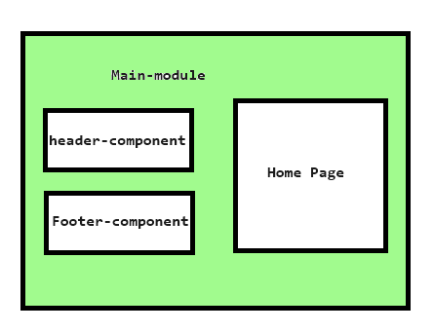

Components vs Module {
forbeginners.html
workshop.css
}
Angular Training - Building Blocks
Notes:
It is particularly well suited to projects that need to scale and to that effect, it is mainly used for enterprise projects.
Its rich official library ecosystem enables great consistency across projects which means that when transferring teams or projects you will only need to learn about the new business domain and not an entirely new way of doing things because another library set choice was made.
It is very well documented and the consistency in the way the framework is used means you are more than likely to find any question you may encounter along your learning journey already answered.
The Angular team takes a lot of pride in how easy they make updating Angular projects, providing easy steps to follow and some fully automated migration.

Slide 44
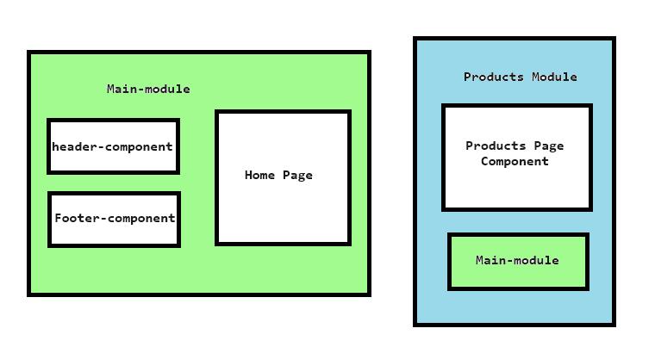

Components vs Module {
forbeginners.html
workshop.css
}
Angular Training - Building Blocks
Notes:
It is particularly well suited to projects that need to scale and to that effect, it is mainly used for enterprise projects.
Its rich official library ecosystem enables great consistency across projects which means that when transferring teams or projects you will only need to learn about the new business domain and not an entirely new way of doing things because another library set choice was made.
It is very well documented and the consistency in the way the framework is used means you are more than likely to find any question you may encounter along your learning journey already answered.
The Angular team takes a lot of pride in how easy they make updating Angular projects, providing easy steps to follow and some fully automated migration.

Slide 45
05 {
[Empower your HTML]
beginners.html
workshop.css
< Binding Types, Directives and Pipes >
}
Angular Training – Empower your HTML

Slide 46
Text Interpolation {
forbeginners.html
workshop.css
< usage of double brackets {{}} >
<h1>
{{ mainTitle }}
</h1>
}
Angular Training - Empower your HTML
Notes:
It is particularly well suited to projects that need to scale and to that effect, it is mainly used for enterprise projects.
Its rich official library ecosystem enables great consistency across projects which means that when transferring teams or projects you will only need to learn about the new business domain and not an entirely new way of doing things because another library set choice was made.
It is very well documented and the consistency in the way the framework is used means you are more than likely to find any question you may encounter along your learning journey already answered.
The Angular team takes a lot of pride in how easy they make updating Angular projects, providing easy steps to follow and some fully automated migration.

Slide 47
Property Binding {
forbeginners.html
workshop.css
< usage of square brackets [] >
<a [href]="url">Link</a>
<button [disabled]="isUnchanged">Disabled Button</button>
}
Angular Training - Empower your HTML
Notes:
*** Without the brackets, Angular treats the right-hand side as a string literal and sets the property to that static value

Slide 48
Class Binding {
forbeginners.html
workshop.css
* can be used to add or remove CSS class names from an element's class attribute
<p [class.my-class-1]="isWarning"></p>
}
Angular Training - Empower your HTML
Notes:
*** Without the brackets, Angular treats the right-hand side as a string literal and sets the property to that static value

Slide 49
Class Binding {
forbeginners.html
workshop.css
* multiple classes can also be bound with the [class] syntax
<!-- classExpression = "my-class-1 my-class-2 my-class-3" -->
<!-- classExpression = {my-class-1: true, my-class-2: false} -->
<!-- classExpression = ['my-class-1', 'my-class-2'] -->
<p [class]="classExpression"></p>
}
Angular Training - Empower your HTML
Notes:
*** Without the brackets, Angular treats the right-hand side as a string literal and sets the property to that static value

Slide 50
Style Binding {
forbeginners.html
workshop.css
* use style binding to set styles dynamically
<!-- Style properties can be written in dash-case or camelCase -->
<nav [style.background-color]="expression"></nav>
<nav [style.backgroundColor]="expression"></nav>
<!-- styleExpression = "width: 100px; height: 100px; background-color: red;" -->
<!-- styleExpression = {width: '100px', height: '100px', backgroundColor: 'red'} -->
<p [style]="styleExpression"></p>
}
Angular Training - Empower your HTML
Notes:
*** Without the brackets, Angular treats the right-hand side as a string literal and sets the property to that static value

Slide 51
NgClass Directive {
forbeginners.html
workshop.css
<!-- toggle the "special" class on/off with a property -->
<div [ngClass]="isSpecial ? 'special' : ''">This div is special</div>
<!-- toggle the "saveable" class on/off depending on canSave -->
<!-- toggle the "modified" class on/off depending on isUnchanged -->
<!-- toggle the "special" class on/off depending on isSpecial -->
<div [ngClass]="{saveable: canSave, modified: !isUnchanged, special: isSpecial}">
NgClass test div
</div>
}
Angular Training - Empower your HTML
Notes:
*** Without the brackets, Angular treats the right-hand side as a string literal and sets the property to that static value

Slide 52
NgStyle Directive {
forbeginners.html
workshop.css
<div [ngStyle]="{
'font-style': canSave ? 'italic' : 'normal',
'font-weight': !isUnchanged ? 'bold' : 'normal',
'font-size': isSpecial ? '24px' : '12px'
}">
NgStyle test div
</div>
}
Angular Training - Empower your HTML
Notes:
*** Without the brackets, Angular treats the right-hand side as a string literal and sets the property to that static value

Slide 53
NgModel Directive {
forbeginners.html
workshop.css
<label>
What is your name ?
<input [(ngModel)]="name" />
</label>
<p>Hello {{ name }} !</p>
}
Angular Training - Empower your HTML
Notes:
*** Without the brackets, Angular treats the right-hand side as a string literal and sets the property to that static value

Slide 54
NgModel Directive {
forbeginners.html
workshop.css
* The NgModel directive allows you to bind the value of a form field to a component data item
* It is a two-way binding: the variable is updated when the content of the field changes (typically by the user) and vice versa.
* The syntax for two-way data binding is [()]
}
Angular Training - Empower your HTML
Notes:
*** Without the brackets, Angular treats the right-hand side as a string literal and sets the property to that static value

Slide 55
NgIf Directive {
forbeginners.html
workshop.css
* Use to add or remove an element by applying an ngIf directive to a host element
<!--Will only show Hello, ... if currentCustomer is not null or undefined-->
<div *ngIf="currentCustomer">Hello, {{currentCustomer.name}}</div>
}
Angular Training - Empower your HTML
Notes:
*** Without the brackets, Angular treats the right-hand side as a string literal and sets the property to that static value

Slide 56

NgIf Directive {
forbeginners.html
workshop.css
* An else statement can also be provided
* <ng-template> creates a template fragment, it is not rendered by default. #elseBlock is a template variable that enables to gain a reference to the <ng-template>
<div *ngIf="condition; else elseBlock">Content to render when condition is true.</div>
<ng-template #elseBlock>Content to render when condition is false.</ng-template>
}
Angular Training - Empower your HTML
Notes:
*** Without the brackets, Angular treats the right-hand side as a string literal and sets the property to that static value

Slide 57

NgSwitch Directive {
forbeginners.html
workshop.css
* NgSwitch conditionally swaps the content of the host element by selecting one of the embedded templates based on the current value of condition expression
<div [ngSwitch]="myBeer">
<div *ngSwitchCase="'Ale'">Short fermentation</div>
<div *ngSwitchCase="'Lager'">Long fermentation</div>
<div *ngSwitchCase="'Sour ale'">Crafted from wild yeasts</div>
<div *ngSwitchDefault>No random knowledge for that type of beer, sorry.</div>
</div>
}
Angular Training - Empower your HTML
Notes:
*** Without the brackets, Angular treats the right-hand side as a string literal and sets the property to that static value

Slide 58
NgSwitch Directive {
forbeginners.html
workshop.css
* NgSwitch conditionally swaps the content of the host element by selecting one of the embedded templates based on the current value of condition expression
<div [ngSwitch]="myBeer">
<div *ngSwitchCase="'Ale'">Short fermentation</div>
<div *ngSwitchCase="'Lager'">Long fermentation</div>
<div *ngSwitchCase="'Sour ale'">Crafted from wild yeasts</div>
<div *ngSwitchDefault>No random knowledge for that type of beer, sorry.</div>
</div>
}
Angular Training - Empower your HTML
Notes:
*** Without the brackets, Angular treats the right-hand side as a string literal and sets the property to that static value

Slide 59

NgFor Directive {
forbeginners.html
workshop.css
* Use the NgFor directive to present a list of items
* The element on which NgFor is placed will be repeated for each element in the iterable.
<div *ngFor="let item of items">{{item.name}}</div>
<!-- With a local variable for the index -->
<div *ngFor="let item of items; let i = index">{{i}}: {{item.name}}</div>
}
Angular Training - Empower your HTML
Notes:
*** Without the brackets, Angular treats the right-hand side as a string literal and sets the property to that static value

Slide 60

Event Binding {
forbeginners.html
workshop.css
* Event binding allows you to listen for and respond to user actions such as keystrokes, mouse movements, clicks, and touches or a custom event emitted by a child component.
* To bind to an event you use the Angular event binding syntax ()
<button (click)="delete()">Delete</button>
}
Angular Training - Empower your HTML
Notes:
*** Without the brackets, Angular treats the right-hand side as a string literal and sets the property to that static value

Slide 61
Pipes {
forbeginners.html
workshop.css
* Pipes are data transformation functions usable directly from the template to transform the data to be displayed at binding time
* They don't require to change the data in the component so that it is displayed in a user-friendly way
* They are declared once and can be reused in as many components as needed as they are independent from them
}
Angular Training - Empower your HTML
Notes:
*** Without the brackets, Angular treats the right-hand side as a string literal and sets the property to that static value

Slide 62
Pipes Syntax {
forbeginners.html
workshop.css
* Angular pipe syntax is inspired by the unix shell pipes
* Parameters can be passed to pipes. They are placed after the pipe's name and separated by colons.
* Pipes can be chained
}
Angular Training - Empower your HTML
Notes:
*** Without the brackets, Angular treats the right-hand side as a string literal and sets the property to that static value

Slide 63

Pipes Syntax {
forbeginners.html
workshop.css
<div>{{ user.lastName | uppercase }}</div>
<!-- with parameter -->
<div>{{ user.registrationDate | date:'dd/MM/yyyy' }}</div>
<div>{{ user.registrationDate | date:'dd/MM/yyyy hh:mm':'UTC' }}</div>
<div>{{ user.registrationDate | date:'dd/MM/yyyy hh:mm':'+0200':'fr' }}</div>
<!-- chaining -->
<div>{{ user.birthDate | date | uppercase }}</div>
}
Angular Training - Empower your HTML
Notes:
*** Without the brackets, Angular treats the right-hand side as a string literal and sets the property to that static value

Slide 64

Built-in Pipes {
forbeginners.html
workshop.css
< AsyncPipe unwraps a value from an asynchronous primitive
CurrencyPipe transforms a number to a currency string according to locale rules
DatePipe formats a date value according to locale rules
DecimalPipe formats a value according to digit options and locale rules
I18nPluralPipe maps a value to a string that pluralizes the value according to locale rules
I18nSelectPipe generic selector that displays the string that matches the current value
JsonPipe converts a value into its JSON-format representation, useful for debugging
KeyValuePipe transforms Object or Map into an array of key value pairs
LowerCasePipe transforms text to all lower case
PercentPipe transforms a number to a percentage string, formatted according to locale rules
SlicePipe creates a new Array or String containing a subset (slice) of the elements
TitleCasePipe transforms text to title case
UpperCasePipe transforms text to all upper case >
}
Angular Training - Empower your HTML
Notes:
*** Without the brackets, Angular treats the right-hand side as a string literal and sets the property to that static value

Slide 65

Custom Pipes {
forbeginners.html
workshop.css
< If built-in pipes do not cover a use case you encounter, Angular gives you the opportunity to create a custom one >
import { Pipe, PipeTransform } from '@angular/core'
@Pipe({
name: 'demo'
})
export class DemoPipe implements PipeTransform { transform(value: unknown, ...args: unknown[]): unknown {
return null
} }
}
Angular Training - Empower your HTML
Notes:
*** Without the brackets, Angular treats the right-hand side as a string literal and sets the property to that static value

Slide 66

Using Pipe outside the template {
forbeginners.html
workshop.css
import { Component } from '@angular/core'
import { UpperCasePipe } from '@angular/common'
@Component({
selector: 'app-root',
templateUrl: './app.component.html',
styleUrls: ['./app.component.css'],
providers: [ UpperCasePipe ]
})
export class AppComponent {
constructor(private upperCasePipe: UpperCasePipe) {}
title = this.upperCasePipe.transform('title')
}
}
Angular Training - Empower your HTML
Notes:
*** Without the brackets, Angular treats the right-hand side as a string literal and sets the property to that static value

Slide 67
Exercise { ;
forbeginners.html
workshop.css
}
Angular Training Beginner - Exercise

Slide 68
Thanks; {
forbeginners.html
workshop.css
‘Do you have any questions?’
charles.adison1@lexisnexisrisk.com
< Please keep this slide for attribution >
}
Angular Training Beginner - End

Slide 69


